Slide 1
CS 4530 Software Engineering
Module 13: Principles and Patterns of Cloud Infrastructure
Adeel Bhutta and Mitch Wand
Khoury College of Computer Sciences
Khoury College of Computer Sciences
© 2023 released under CC BY-SA

Slide 2
Learning objectives for this lesson
By the end of this lesson, you should be able to…
  Explain what “cloud” computing is and why it is important
  Describe the difference between virtual machines and containers
  Explain why virtual machines and containers are important in cloud computing
Notes:
<read slide>

Slide 3
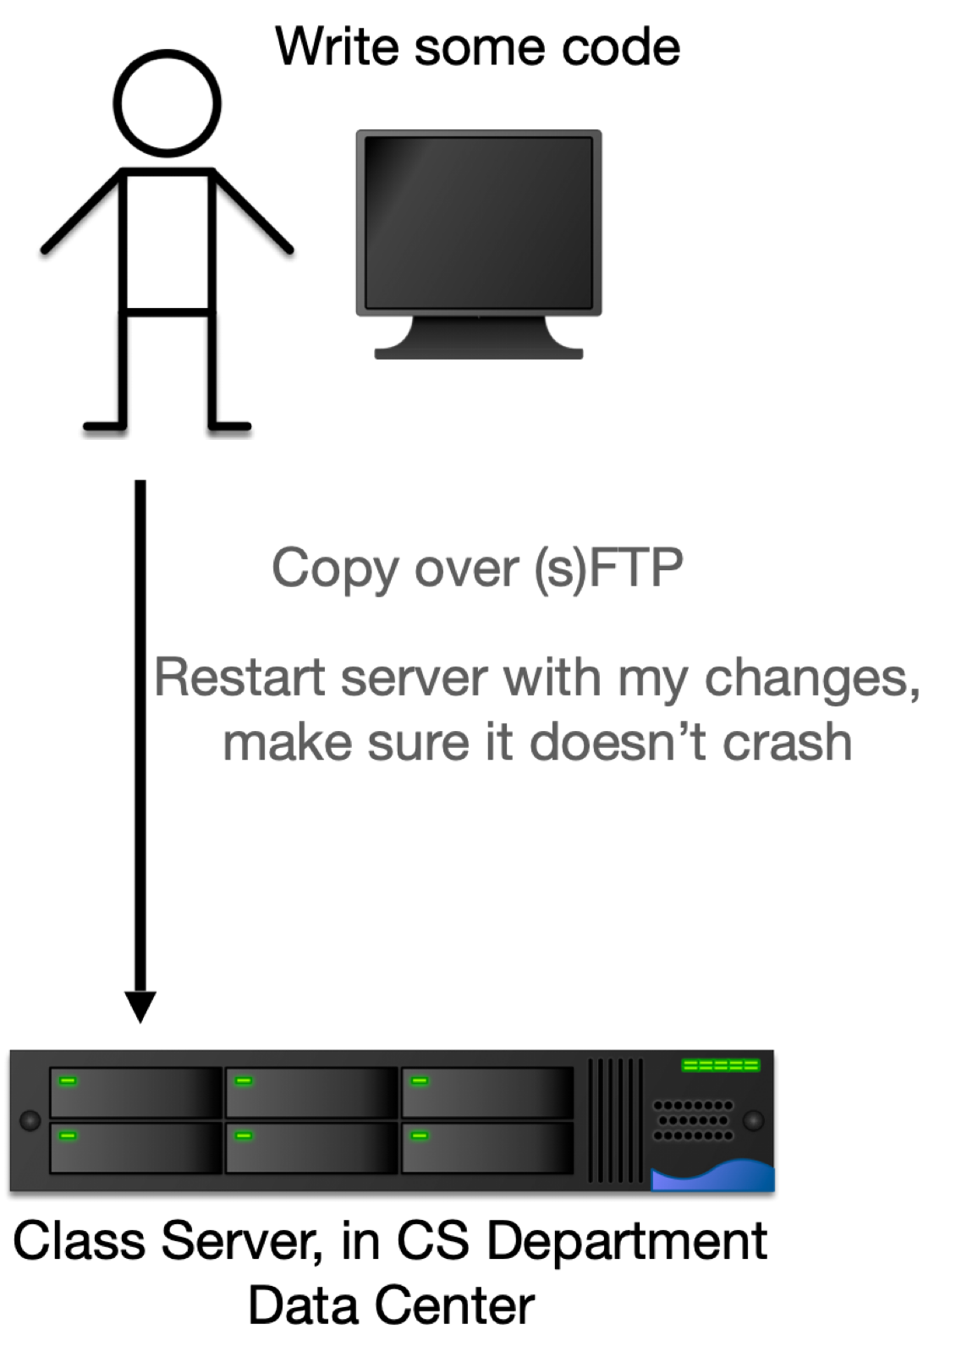
How to deploy web apps?
What we need:
  A server that can run our application
  A network that is configured to route requests from an address to that server
Questions to think about:
  What software do we need to run besides our application code?
  Where does this server come from?
  Who else gets to use this server?
  Who maintains the server and software?
Notes:
* What software to run? -> Do we also need to have a database server, cache, or similar additional software that is not our app code itself, but some sort of “middleware”?
Where does this server come from? -> Do we have to buy it? Are we borrowing it?
Who else gets to use the server? -> Is this a “multi-tenant” machine, where other users also have code running on it? Or just us?
Who maintains the server and software? -> Range from physical issues (power, cooling for machine, replacing broken components) to operating system (who updates the operating system…) and maintenance of any of this middleware that we need (e.g. database)

Slide 4
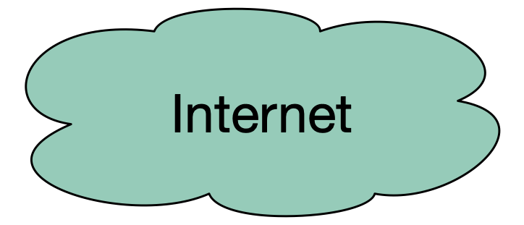

Many apps rely on common infrastructure
  Content delivery network: caches static content “at the edge” (e.g. cloudflare, Akamai)
  Web servers: Speak HTTP, serve static content, load balance between app servers (e.g. haproxy, traefik)
  App servers: Runs our application
  Misc services: Logging, monitoring, firewall
  Database servers: Persistent data
Content Delivery Network
Clients
Web Servers
App Servers
Misc Services
Database servers
Notes:
(Read slide)
Examples of why we need these things:
content delivery networks (CDNs) are helpful because they are very plentiful, but “dumb” caches. “Edge” means that they are located near customers, all around the world (the “edge” of the cloud). CDNs are really good for managing high volumes of load because the load is amortized across all of the CDN’s clients. A 100x influx in traffic for our app might be a lot, but on the scale of what CloudFlare or Akamai handle all day long, it’s a drop in the bucket. Hence, these systems are also effective for protection against “denial of service” (DoS) attacks. Before cloud flare existed to provide basically a free CDN to anyone who wants it, it was not very difficult to force a web app to stop working by overwhelming it with traffic.
Web servers are the “edge” of our app, and receive HTTP(s) traffic, forwarding it on to our application, and also possibly interacting with some misc services
App servers are running our actual application. For example, our transcript server API. We might want to have multiple app servers (for scalability), so the web server in front provides an opportunity for load balancing across them
Misc services could include things like logging, monitoring, and even an application firewall (e.g. some kind of anomaly detection system that identifies potentially malicious behavior and prevents it from reaching our app)
Database servers are where we store the persistent data…

Slide 5
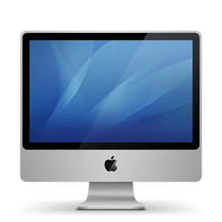
Many apps typically share the same infrastructure
Content Delivery Network
Client 1
App 1
Web Servers
Client 2
App 2
App Servers
Misc Services
Client 3
App 3
Database servers
Notes:
How do we share the resources among the different clients?

Slide 6
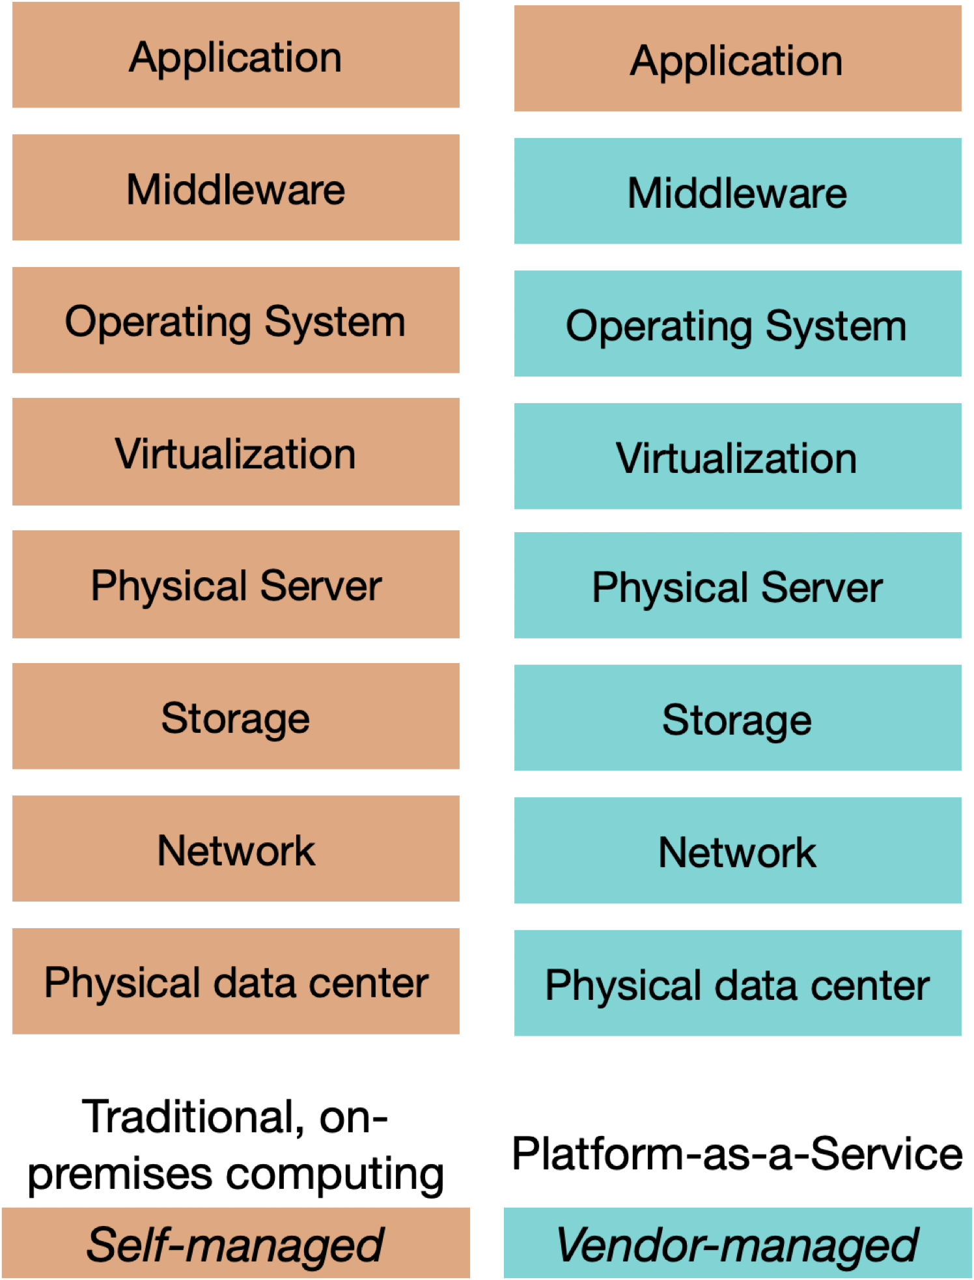
What is the infrastructure that needs to be shared?
Our apps run on a “tall stack” of dependencies
Traditionally this full stack is self-managed
Cloud providers offer products that manage parts of that stack for us:
  “Infrastructure as a service”
  “Platform as a service”
  “Software as a Service”
Notes:
So, if we look deeper into that application, we might see that our application actually runs on a tall “stack” of different physical and logical components. Managing this all can be a full-time job for a small team!
Traditionally, this whole stack is self-managed, but there are many different infrastructure options available to us that vary the degree to which an infrastructure provider manages them for us.
The figure on the right shows the components that might make up our “stack”, and one example of what a cloud provider might provide in a model called “platform as a service.”
In a platform as a service model, the *only* thing that we provide is our application (e.g. a nodeJS app), and are not involved in the deployment or configuration of the “middleware” (like the load balancer, logging, monitoring, firewall, etc).
From the bottom up, the PaaS provider will manage:
Physical data center (need to provide power and cooling; physical security)
Network (connectivity between our servers and to the outside world)
Storage (application might have larger storage requirements than what fits on a single server, or might require shared storage)
Physical server (the “bare metal” machine, with CPUs and RAM)
Virtualization (might be running on a slice of that physical machine)
Operating system (in a PaaS model, the vendor even manages the OS, so we don’t have to think about having or needing one)
Middleware (something that interfaces with our application, beyond the operating system. An example is a load balancer for web traffic, or Kubernetes for orchestrating containers)
Application (us…)
In today’s lecture, we will discuss the different abstractions that cloud providers offer us for deployment, and the tradeoffs of those abstractions

Slide 7
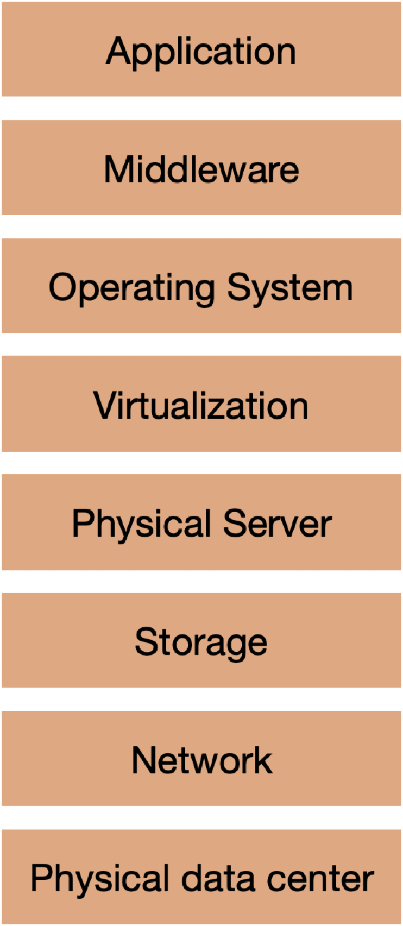
Cloud infrastructure creates economies of scale
At the physical level:
  Multiple customers’ physical machines in the same data center
  Save on physical costs (centralize power, cooling, security, maintenance)
At the physical server level:
  Multiple customers’ virtual machines in the same physical machine
  Save on resource costs (utilize marginal computing capacity)
At the application level:
  Multiple customer’s applications hosted in same virtual machine
  Save on resource overhead (eliminate redundant infrastructure like OS)
Multiple customers could share each of these tiers
Notes:
Before getting into the patterns of how to use cloud infrastructure, we should discuss some of the core concepts that are provided by all cloud platforms.
One of the core concepts of cloud computing is that infrastructure is concentrated, allowing vendors operating the infrastructure to achieve economies of scale. This scale could happen at any of the tiers on the diagram on the right.
For example (read slide)

Slide 8
Cloud infrastructure scales elastically
“Traditional” computing infrastructure requires capital investment
  “Scaling up” means buying more hardware, or maintaining excess capacity for when scale is needed
  “Scaling down” means selling hardware, or powering it off
Cloud computing scales elastically:
  “Scaling up” means allocating more shared resources
  “Scaling down” means releasing resources into a pool
  Billed on consumption (usually per-second, per-minute or per-hour)
Notes:
Let’s contrast the traditional and cloud computing!
(Read slide)
Perhaps the most important part to understand about the “elastic” scale is that you can add more resources just for when you need them, and only pay for those resources when you are using them.
(Sidebar - Amazon EC2, and the cloud as we know it, arguably came out of Amazon’s need to have very elastic scaling of their original e-commerce business to support periods of heavy demand around holidays, black friday. Pre-EC2, it was not uncommon for stores and websites to go offline under heavy load. Amazon built a system that provided resilient scaling to their e-commerce division, then started to sell off their excess computing capacity when it wasn’t, for example, black friday, and they didn’t need it. Many “cloud” companies have similar origin stories)

Slide 9
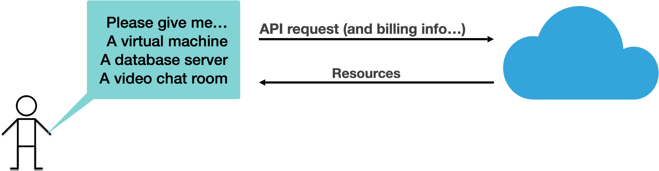
Cloud infrastructure gives on-demand access to resources
Vendor provides a service catalog of “X as a service” abstractions
API allows us to provision resources on-demand
Notes:
However: the part of what makes it “the cloud” most, perhaps, is the ability to have *on-demand* and fully *self-service* access to resources. Those resources might be low-level abstractions (like virtual machines), or high-level abstractions (like some software, run as a service), but the key here these are “___ as a service” - the vendor provides the X as a service to us.
There are many different “as a service” abstractions that cloud providers offer (those XaaS buzzwords), and we will discuss the difference between them soon. However, what is important is that all of these abstractions can be provisioned with an on-demand self-service model. You can simply go to a web portal, pick the resource that you want (which might range from something that the vendor does little to manage, like a virtual machine, to something where the vendor does more management, like a hosted database server, or an entire application that the vendor runs for you, like a video chat server). Whatever the resource is, we have an automated approach to provision it.

Slide 10
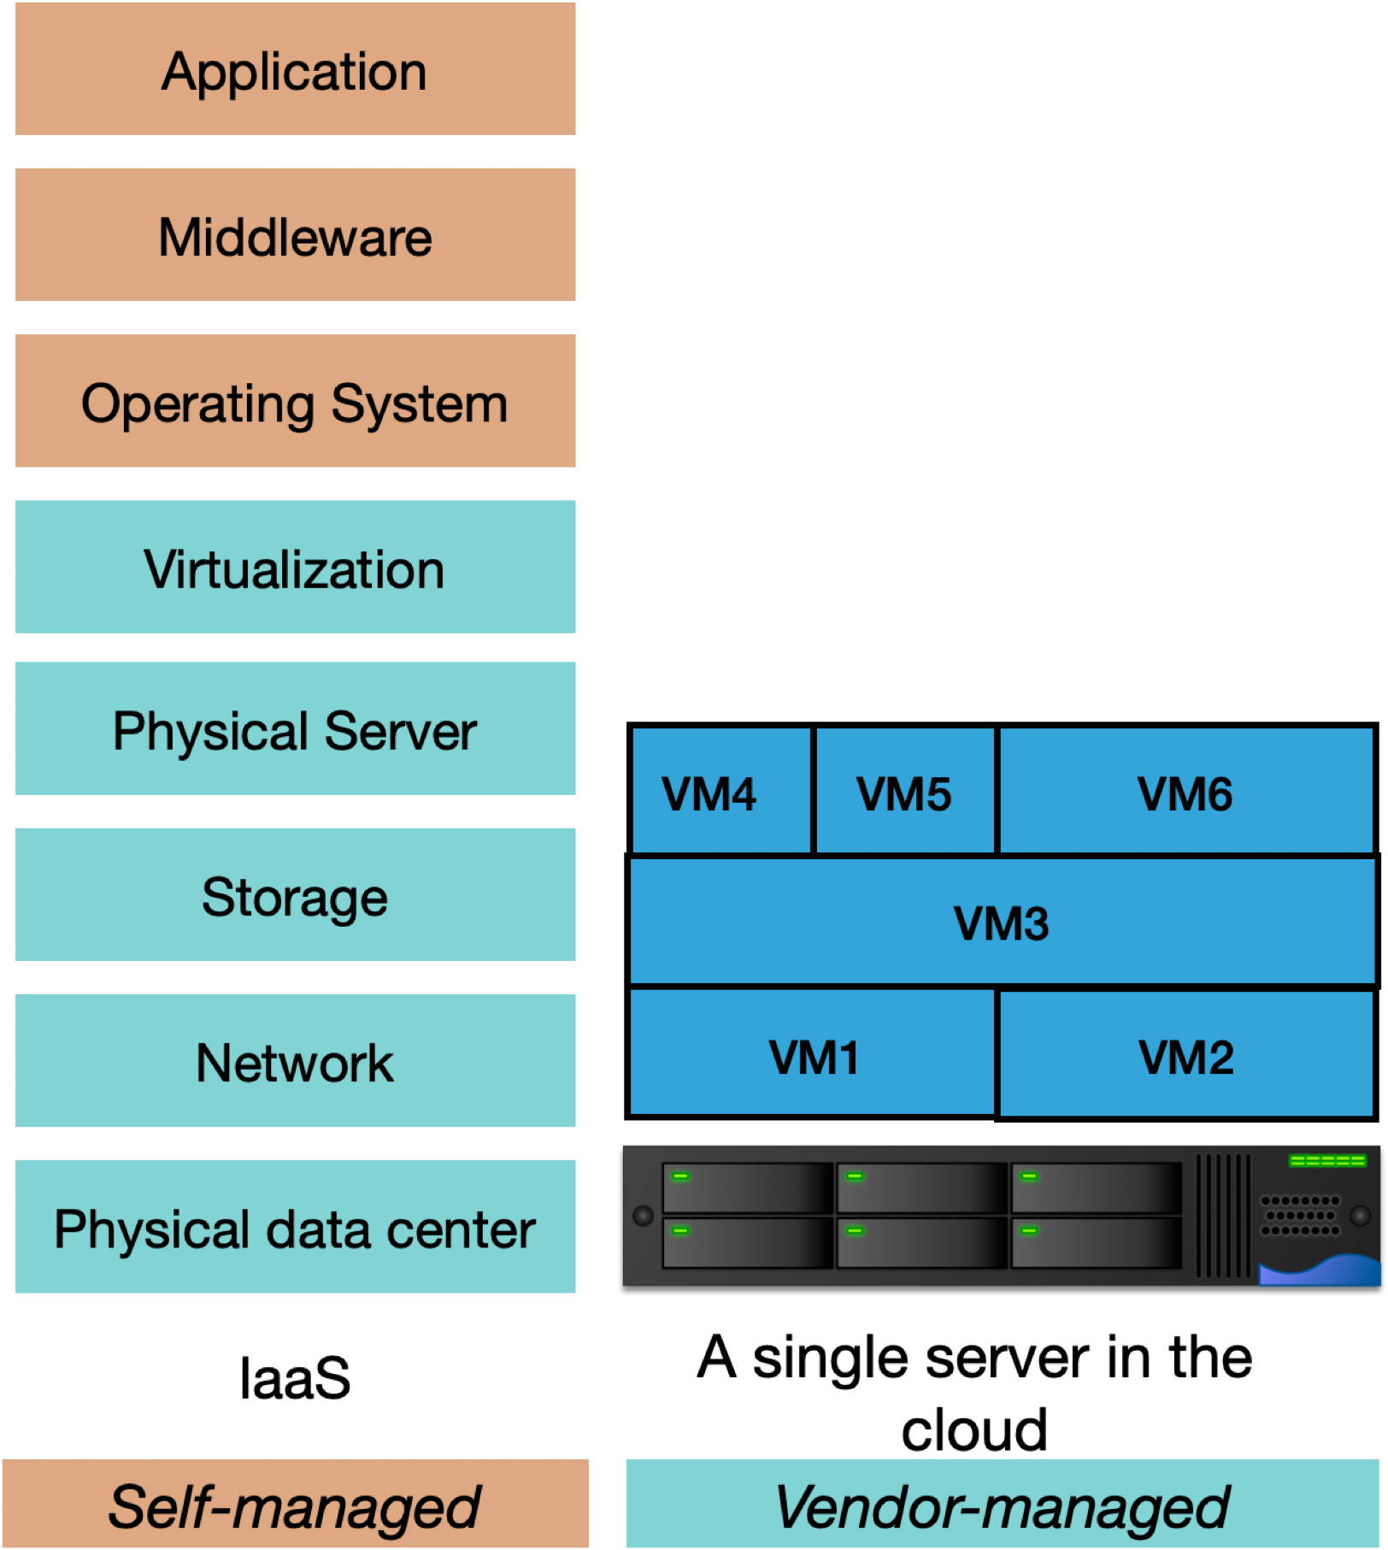
Infrastructure as a Service: Virtual Machines
Virtual machines:
  Virtualize a single large server into many smaller machines
  OS limits resource usage and guarantees quality per-VM
  Each VM in its own OS
  Examples: Amazon EC2, Google Compute Engine, Azure
Notes:
One of the earliest forms of infrastructure-as-a-service provided by cloud vendors was virtualization. With virtualization, a single physical server can be split into multiple “virtual servers”, which enforce resource limits and quality guarantees per-VM. Each VM runs its own operating system, and the software running in the VM is agnostic to the fact that there is a VM instead of a physical server that runs it.
Although the idea of Virtualization started with IBM’s mainframe, it really became popular when Vmware introduced its x86 server called ESC Server in 2000s.

Slide 11

Let’s look more closely at this software stack
The “instruction set” is an abstraction of the underlying hardware
The operating system presents the same abstraction + OS calls.
Your App
App Dependencies
ISA+OS Calls
Operating System
ISA
Hardware
Notes:
Real hardware is immensely complicated– it’s got all kinds of registers and locks and microprogramming, which you can learn about in a computer architecture course. The “hardware layer” presents an abstraction of this underlying hardware, called the “instruction set architecture”.
The operating system presents another abstraction, typically consisting of the machine instructions (the ISA) plus a variety of system calls that operate at a higher level, such as input-output, memory management, etc.
If your app is compiled, it produces some native code from the ISA plus calls to its various dependencies.

Slide 12
The operating system allows several apps to share the underlying hardware
App1
App2
App1 Dependencies
App2 Dependencies
ISA+OS Calls
Operating System
ISA
Hardware
Notes:
These might be multiple apps being run by the same user (as in Windows or iOS), or apps from different users, as in old-fashioned time-sharing systems. This technology dates back to the 1960’s, if not before.

Slide 13
A virtual machine layer allows several different operating systems to share the same hardware
Virtual Machine 1
Virtual Machine 2
App1
App2
App1
App2
App1 Dependencies
App2 Dependencies
App1 Dependencies
App2 Dependencies
OS1
OS2
ISA
ISA
Virtual Machine Manager
ISA
Hardware
Notes:
A “virtual machine manager” allows multiple operating systems & their applications to share the same hardware. You might have a windows OS and a Linux OS running on the same physical machine. Virtual machines give stronger isolation guarantees than a traditional operating system offers: two VMs will, for example, have two different sets of registers.
Note that a VMM is not an emulator; it just passes through ISA instructions when it can, and dispatches results of the physical machine instructions to the registers of the appropriate virtual machine.

Slide 14
Virtual Machines facilitate multi-tenancy
Multi-Tenancy
  Multiple customers sharing same physical machine, oblivious to each other
Decouples application from hardware
  virtualization service can provide “live migration”
Faster to provision and release
  VM v. physical machines == ~mins v. ~hours
Notes:
It is important to understand the significance of VMs in the development of cloud infrastructure.
“Multi-tenancy” is a key concept in cloud computing
While various mainframe systems have provided time-sharing (multiple users apps running on same platform), these systems often required specialized software development models, and/or did not provide the same rigid isolation that could be achieved by running those applications on separate physical machines.
VMs bring the idea of “multi-tenancy” to commodity computing. With VMs, we can have multiple customers share the same machine, oblivious to each other - each one running their own OS, and with their own guaranteed performance levels. (NB of course you could also over-provision if that was the goal…)
Asingle server can now host multiple VMs, each of which might receive a different slice of the server’s resources.
Another significant improvement of VMs over deployment directly on physical machines is resilience: the entire application (and its OS!) are now fully decoupled from the physical machine, and the virtualization service could provide a “live migration” feature, moving VMs between physical machines without any noticeable service interruption. This is a core concept that is implemented by all cloud virtualization providers, and is important to ensure that our apps can remain oblivious to hardware failures: if a component begins to fail, a VM can be migrated off of that physical machine. If a physical machine fails entirely, the VM can be restarted from another (assuming that the VM image is not lost in the failure)
VMs are also significantly faster to provision than physical machines. It is common for VMs to be launched within minutes of a request, whereas a request to provision (or release) a physical machine might take significantly longer.

Slide 15
Virtual Machines to Containers
Each VM contains a full operating system
What if each application could run in the same (overall) operating system? Why have multiple copies?
Advantages to smaller apps:
  Faster to copy (and hence provision)
  Consume less storage at rest
Notes:
(Read slide)
This problem surfaced within Google in the mid 2000’s, resulting in the development of Linux control groups (cgroups), containers, and docker

Slide 16
Infrastructure as a Service: Containers
Each application is encapsulated in a “lightweight container,” includes:
  System libraries (e.g. glibc)
  External dependencies (e.g. nodejs)
“Lightweight” in that container images are smaller than VM images - multi tenant containers run in the OS
Cloud providers offer “containers as a service”
(Amazon ECS Fargate, Azure Kubernetes,
Google Kubernetes)
Notes:
<read slide>
Kubernetes came out of Google, original internal system was called “Borg”. Automatic Deployment for multiple dockers. It allows you to declare a configuration file like this: “Give me …”. It will manage docker containers for these components on different machines. It could also share services between customers.
Paper: Large-scale cluster management at Google with Borg (2015)
https://research.google/pubs/pub43438/

Slide 17
A container contains your apps and all their dependencies
You might put several apps in a single container, together with their dependencies
Might have only one copy of shared dependencies
Container 1
Container 2
App1
App2
App1
App2
App1 Dependencies
App2 Dependencies
App1 Dependencies
App2 Dependencies
ISA+OS Calls
Operating System
ISA
Hardware

Slide 18
Infrastructure as a Service: with containers
Vendor supplies an on-demand instance of an operating system
  Eg: Linux version NN
Vendor is free to implement that instance in a way that optimizes costs across many clients.
Container 1
Container 2
App1
App2
App1
App2
App1 Dependencies
App2 Dependencies
App1 Dependencies
App2 Dependencies
ISA+OS Calls
Operating System
We don’t care what’s under here: it’s an abstraction!
ISA
Hardware

Slide 19
Infrastructure as a Service: Docker
Docker provides a standardized interface for your container to use
Many vendors will host your Docker container
Container 1
Container 2
App1
App2
App1
App2
App1 Dependencies
App2 Dependencies
App1 Dependencies
App2 Dependencies
Docker
Operating System
We don’t care what’s under here: it’s an abstraction!
ISA
Hardware

Slide 20
Platform-as-a-Service: vendor supplies OS + middeware
Middleware is the stuff between our app and a user’s requests:
  Load balancer: route client requests to one of our app containers
  Application server: run our handler functions in response to requests from load balancer
  Monitoring/telemetry: log requests, response times and errors
Cloud vendors provide managed middleware platforms too: “Platform as a Service”
Application
Application
Middleware
Middleware
Operating System
Operating System
Virtualization
Virtualization
Physical Server
Physical Server
Storage
Storage
Network
Network
Physical data center
Physical data center
IaaS: Containers
PaaS
Self-managed
Vendor-managed
Notes:
We’re now on the path of having the vendor manage more and more of the infrastructure your software needs.
The next logical step is for the vendor to supply some or all of your middleware.
<read slide>
Middleware is fussy: writing it requires expertise that your team may not have. A vendor can probably do it better than you can. And middleware can be shared across apps and clients , making it even more economical for a vendor to supply it.

Slide 21
PaaS is often the simplest choice for app deployment
Platform-as-a-Service provides components most apps need, fully managed by the vendor: load balancer, monitoring, application server
  Heroku, AWS Elastic Beanstalk, Google App Engine
Some PaaSs deploy apps as single functions invoked only when a web request is made
  AWS Lambda, Google Cloud Functions, Azure Functions
Some PaaSs provide databases and authentication
  Google Firebase, Back4App
Application
Middleware
Operating System
Virtualization
Physical Server
Storage
Network
Physical data center
PaaS
Notes:
<read slide>
Notice that in this diagram all the client supplies is the app; the vendor provides all the other layers.

Slide 22
Heroku’s PaaS
Takes a web app as input
  No container, only need entry point to code, e.g. “npm start”
Hosts web app at chosen URL, can scale resources up/down on-demand
  Load balancer fully managed by Heroku, scaling transparent
  Auto-scale down to use no resources, spins up container on reception of a request
  Dashboard for monitoring/reporting
HTTP requests
Load balancer + traffic monitor
Container
Container
Our NodeJS App
Our NodeJS App
Notes:
Heroku is a platform-as-a-service specialized for web apps.
(Read slide)
What is neat about Heroku’s platform is that they share the load balancing work among so many clients that the cost of the load balancer is basically free. All requests go through the load balancer. As a result, the platform can turn off your app when it’s idle, and turn it back on if it gets a request that it needs to satisfy.

Slide 23
Software as a Service adds more vendor-managed apps
Providers may also develop custom software offered only as a service
Examples:
  PostgreSQL (open source)
  Twilio Programmable Video (proprietary chat)
Application
Application
Middleware
Middleware
Operating System
Operating System
Virtualization
Virtualization
Physical Server
Physical Server
Storage
Storage
Network
Network
Physical data center
Physical data center
IaaS
SaaS
Self-managed
Vendor-managed
Notes:
<read slide>

Slide 24
Self-managed vs Vendor-managed Infrastructure
Benefits to vendor-managed options:
  More ways to reduce resource consumption, improve resource utilization
  Less management burden
  Less capital investment, greater operating expenses
Benefits to self-managed options:
  Greater flexibility and avoid vendor lock-in
  More capital investment, less operating expenses
Application
Application
Application
Middleware
Middleware
Middleware
Operating System
Operating System
Operating System
Virtualization
Virtualization
Virtualization
Physical Server
Physical Server
Physical Server
Storage
Storage
Storage
Network
Network
Network
Physical data center
Physical data center
Physical data center
Traditional, on-premises computing
IaaS
SaaS
Self-managed
Vendor-managed
Notes:
As we have seen, there is a wide spectrum between traditional, on-premises computing, infrastructure as a service, platform as a service, and software as a service options.

Slide 25
Cloud Infrastructure is best for variable workloads
Consider:
  Does your workload benefit from ability to scale up or down?
Example:
  need to run 300 VMs, each 4 vCPUs, 16GB RAM
Private cloud:
  Dell PowerEdge Pricing (AMD EPYC 64 core CPUs)
  7 servers, each 128 cores, 512GB RAM, 3 TB storage = $162,104
Public cloud:
  Amazon EC2 Pricing (M5.xlarge instances, $0.121/VM-hour)
  10 VMs for 1 year + 290 VMs for 1 month: $36,215.30
  300 VMs for 1 year: $317,988
Notes:
Cloud infrastructure makes sense when you expect the need to be able to scale up and down, and where the amount that you need to scale by is larger than your normal capacity needed.
For example: imagine that we are building a system that needs to be able to scale up in resources to go up to using 300 VMs, each with 4 CPUs and 16 GB RAM.
(Click) If we are buying hardware ourselves for this, we might buy something like these Dell PowerEdge servers, each with 128 cores and 512GB RAM, giving us enough capacity to scale up to 300 VMs (plus some extra CPUs + RAM for managing this whole cluster). In July 2021 this cost $162,104.
What would this cost for a year if we went to Amazon? (Click) We could get virtual machines at $0.121/hour. If our baseline infrastructure requirement was just to have 10 VMs for the year, and we projected that only at peak loads we would need to scale up (to say, another 290 VMs for 1 month), the total cost at the end of the year would be $36,215.30. We would definitely save some cash compared to the self-hosted option (plus the hassle of procuring and managing that cluster).
But: what if we needed all 300 VMs for the entire year? Using EC2 this would cost $317,988 - nearly twice the cost of the self-managed option (and it’s just for one year! Once you buy the servers they will last for hopefully quite a few years!).
Self-managing a cluster like this requires a place to put them, power, and cooling - plus the administration of the software. (this dell cluster draws up to 90 amps of power, which is roughly half of the power that typically service as a house).
(The EC2 pricing was taken on Oct 16, 2022. The pricing includes the discount that you would receive for guaranteeing a year of compute time per-VM.
Dell pricing from July 2021, includes enterprise discount for Northeastern
The astute reader will note that amazon gives you 4 “vCPUs” which means 2 physical CPU cores, each of which are hyper threaded. The 7 x 128c option gives you a few extra cores to spare)

Slide 26
Public clouds are not the only option
“Public” clouds are connected to the internet and available for anyone to use
  Examples: Amazon, Azure, Google Cloud, DigitalOcean
“Private” clouds use cloud technologies with on-premises, self-managed hardware
  Cost-effective when a large scale of baseline resources are needed
  Example management software: OpenStack, VMWare, Proxmox, Kubernetes
“Hybrid” clouds integrate private and public (or multiple public) clouds
  Effective approach to “burst” capacity from private cloud to public cloud
Notes:
As we saw on the last slide, public clouds may not be the most cost-effective option when a workload has a high baseline resource requirement - like needing to have 300 x 4 core VMs running all of the time.
(Read slide)
A “hybrid” cloud option could prefer to consume resources from our on-premises resource, only “bursting” to use public cloud services when the private cloud reaches a capacity threshold

Slide 27
Review
You should now be able to…
  Explain what “cloud” computing is and why it is important
  Describe the difference between virtual machines and containers
  Explain why virtual machines and containers are important in cloud computing

